Slide 1

DriverPass System Analysis
Pasco Logan
Notes:
[No speaker notes required for this slide.]

Slide 2

System Requirements
Functional Requirements:
The system shall validate user credentials when logging in.
The system shall provide the user with available appointments for them to schedule, modify or cancel.
Non-Functional Requirements:
The system should be web-based in the form of a website. And preferably run over the cloud.
The owner wants to be able to access data from any computer or mobile device
Notes:
[In your speaker notes, include an explanation of the different requirements you determined for DriverPass’s system. What are the functional requirements you selected to describe? What are the nonfunctional requirements you selected to describe? Be sure to explain how these requirements meet DriverPass’s needs.]

Slide 3
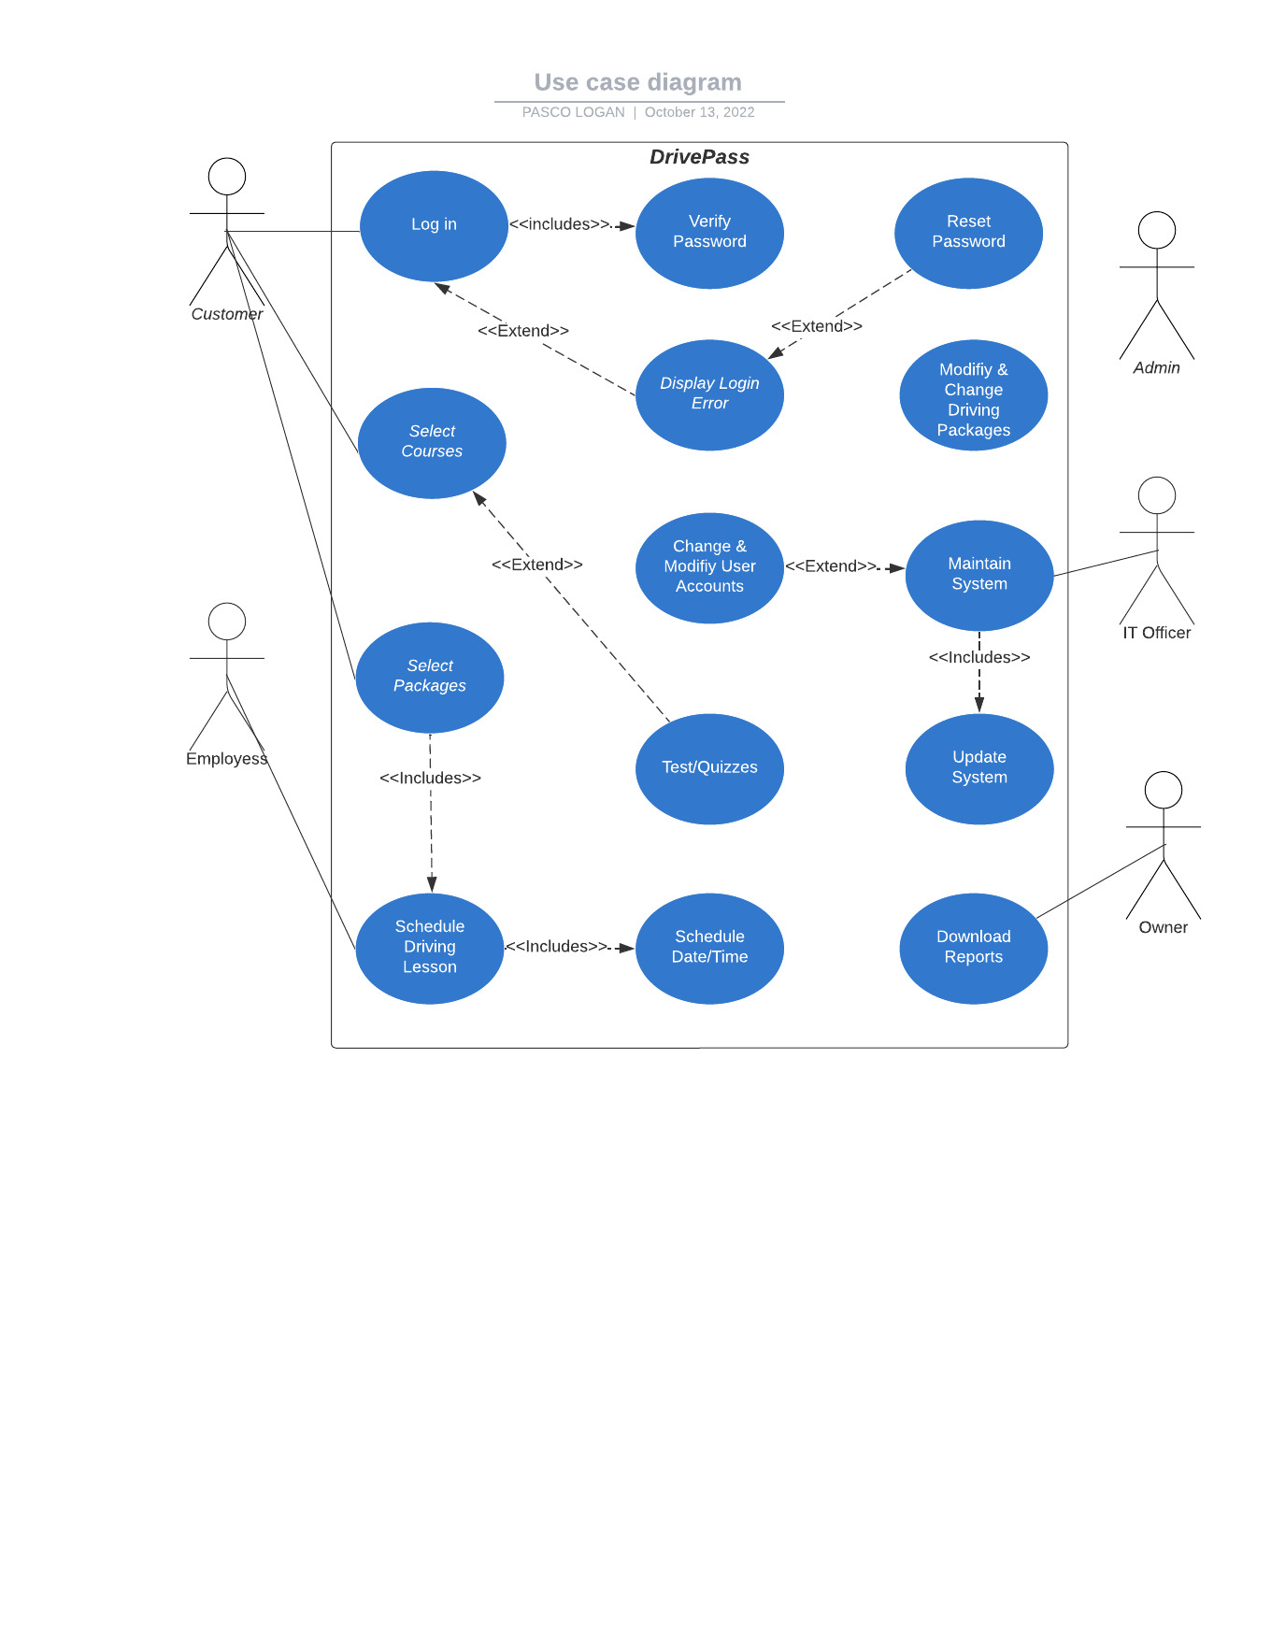
Use Case Diagram
Notes:
[Explain your diagram. Who are the different actors in the system? What are the different use cases? How did you account for DriverPass’s needs in your design? In your explanation, keep your audience in mind. Avoid the use of terms like “actors” and “use cases” in your explanation.]

Slide 4
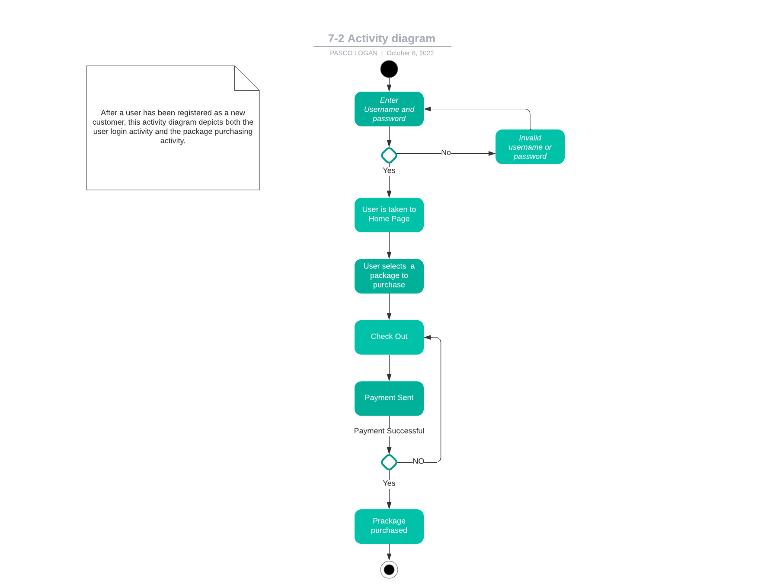
Activity Diagram
Notes:
[Explain your diagram. Which use case are you breaking down? What are the steps for this use case? How did you account for DriverPass’s needs in your design? In your explanation, keep your audience in mind. Avoid the use of technical terms such as “nodes,” “control flows,” and so on.]

Slide 5
Security
Logging into the system requires a username and password.
• The transfer of information between the client and server will be handled by the cloud/server.
• Multi-factor authentication will be used
when logging into the site.
• After three unsuccessful attempts to access your account, you will be locked out.
•Password reset links are sent to the user's registered email address in the event that they forget their password.
Notes:
[How did you consider security in your design? In your explanation, keep your audience in mind by avoiding the use of technical terms.]

Slide 6
System Limitations
Due to the lack of a fixed budget, estimates must be used.
• Since we began gathering requirements on January 22 and our sign-off meeting will conclude on May 10, we have just over three months to complete the process.
•. Since the system is web-based, and the possibility of providing customers with a mobile version was not considered, I anticipate that there will be certain technological restrictions.
•In the absence of an internet connection, the system will be inoperable.
Notes:
[What are the limitations of your design? In your explanation, keep your audience in mind by avoiding the use of technical terms.]

